Slide 1
Unit 8 Don't push, please

Slide 2
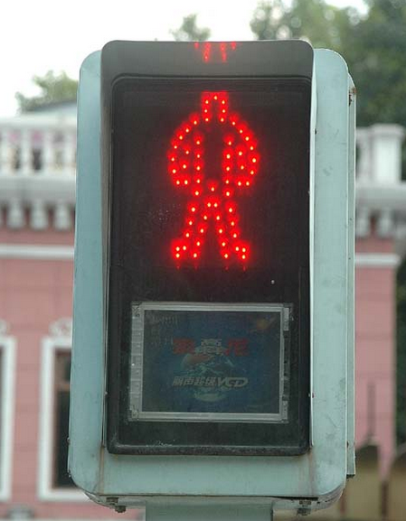
Don’t walk！

Slide 3
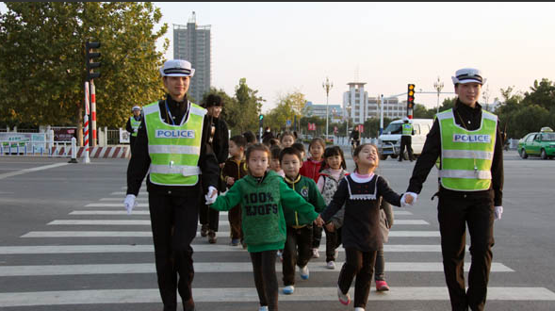
When you cross the road, what should you do?
Look right.
Look left.
Look right, again.

Slide 4
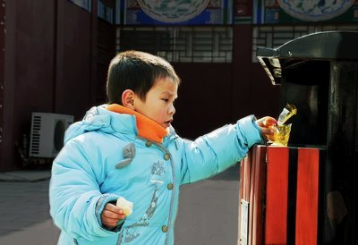
Don’t litter！

Slide 5

Don’t touch！

Slide 6
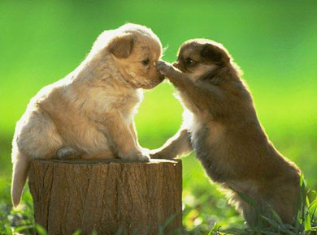

worry
Don’t worry！

Slide 7
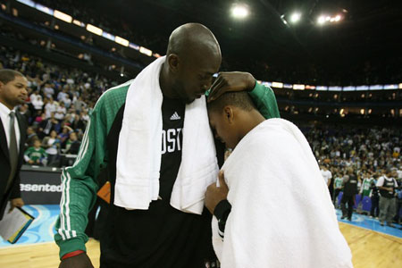
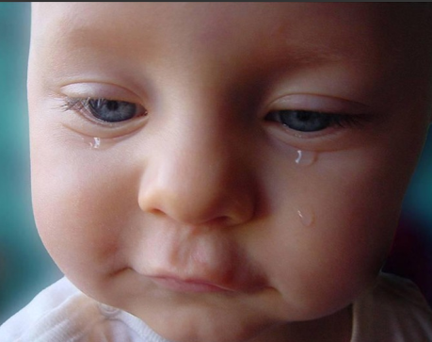
cry
Don’t cry！

Slide 8
Summary
We’ve learned
Don’t…

Slide 9






Look at some signs

Slide 10
Homework
Listen to the tape.(听磁带，跟读故事3遍。)
Try to retell the story. (试着复述故事)

